Slide 1
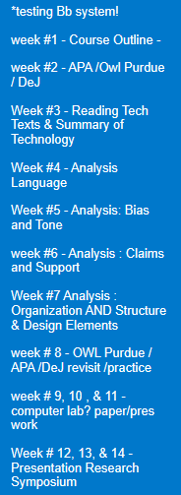
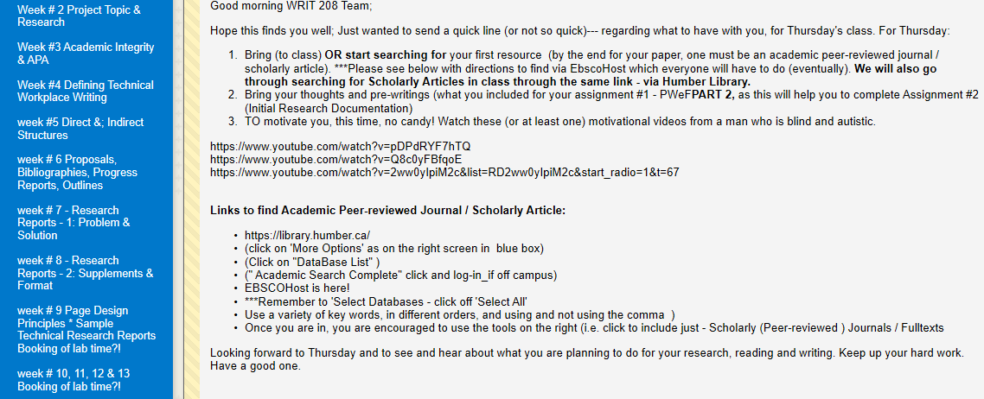
WRIT 120
Did you see the email I sent you? (it is above if needed ) / get onto Bb ☺

Slide 2


Project TOPIC & RESEARCH Initial Research Interest Documentation
Writ 120 – Week #2b September 12-2019

Slide 3
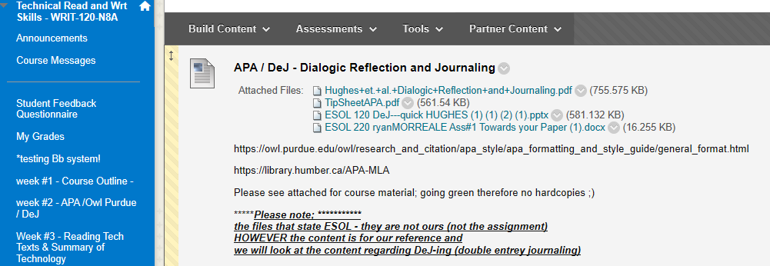

…for YOUR individual readings for each week/class.
Please do CHECK out Bb (blackboard)…

Slide 4

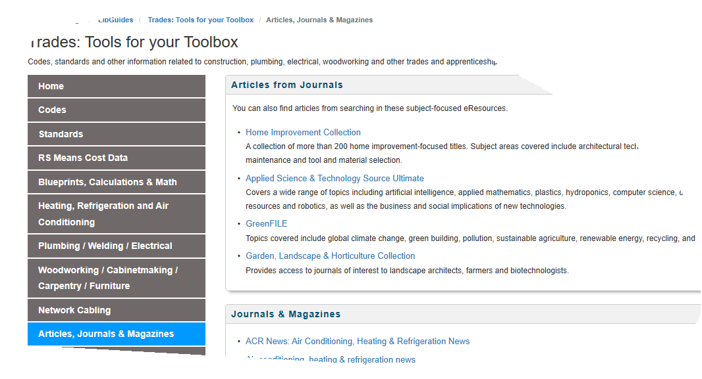
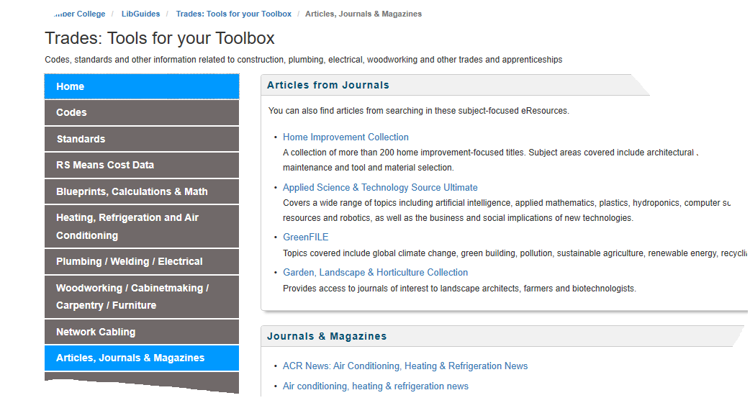
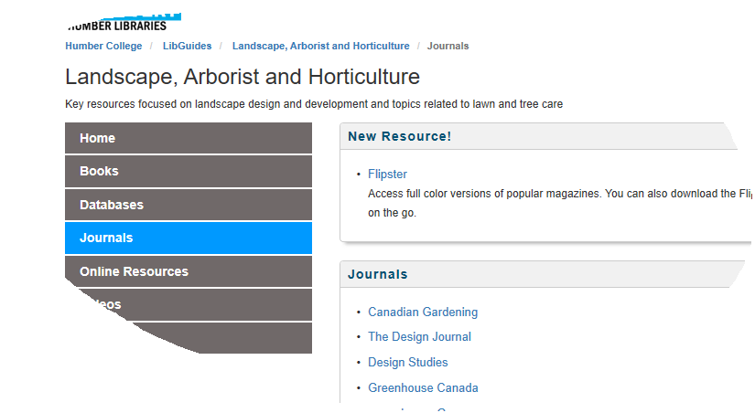
Humber Libraries More Options My Program / Topic
Then select your program of study
Great tool for you / another way to get into scholarly articles
Here is where I would like to take questions regarding finding resources via Humber Libraries & APA documentation – Owl Purdue and Humber Libraries have great tools/resources

Slide 5
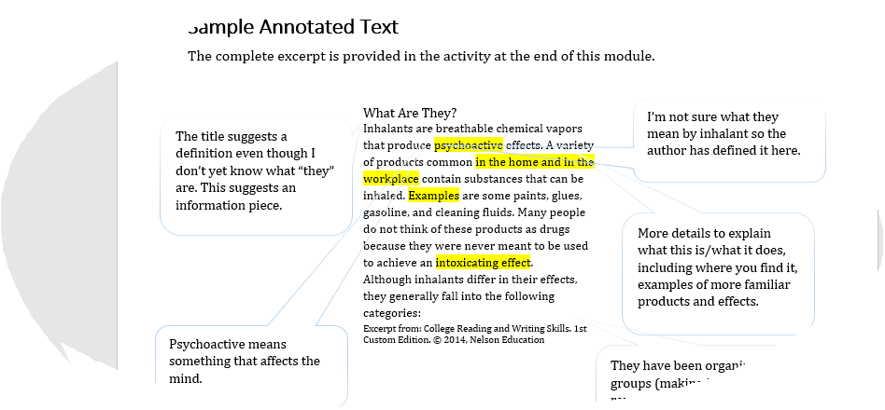
Is it messy? Yes it can!
Skimming
Scanning
Annotating – See video link
Understanding the context –look up words, highlight, add your thoughts in the margins –see video link
https://www.youtube.com/watch?v=tOC_Y9mOcy0

Slide 6
After Reading
Reading
When reading about a technology or mechanism, you often read text that uses highly specialized language, includes technical details, and often provides descriptions of what mechanisms look like, explanations of how they work, and examples of similar technologies. This may make reading a much a slower, more challenging activity than reading a blog, general interest article, or tweet.
When you read, remember these tips:
Annotate the text:
Highlight key phrases or ideas
Circle words/phrases that you need to look up
Underline important words
Find words or phrases that indicate examples, comparisons
Read more than once
Take breaks when reading
Stop to think about your prior knowledge of this topic – make connections
Complete your Double Entry Journal
Re-reading and finding patterns
Reading a text more than once helps you to understand the text. Often, in a first reading, a reader looks for basic information. In a second reading, you can focus on organization, tone, as well as on a more detailed look at the information. You can then begin to look for flaws in the reading – missing information, bias, faulty logic in addition to finding patterns in the author’s wording and ideas.

Slide 7
Is a summary of a technology similar to an article summary?
In a typical summary, your job is to communicate only the important aspects of an article, lecture or interview; in other words, you are to explain the author’s viewpoint but in your own words. This skill is necessary to help convey those ideas to others who have not read the text or to show others that you understand the text.
However, as an expert in your technical field, you may also be asked to create a summary of a technology, mechanism, concept or process to those who are not familiar with it, including clients (existing or potential), coworkers, or managers. Basically, this information helps those who need to or want to know about this technology see what it looks like such as someone who needs to build, operate, or maintain it.

Slide 8
A technology summary:
Describes what a technology looks like
Explains how it works
May be written in sentence/paragraph structure but also can include lists, diagrams and other visual elements
Can be created from more than one source text
Does not give instructions on how to use a technology

Slide 9
Great sections to pull out while DeJ-ing
Describing technology via
DeJ too

Slide 10
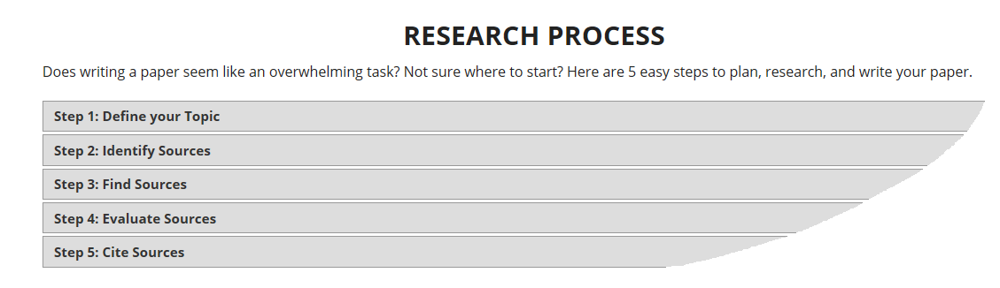

Please remember each of us will have a different process of research. One thing you must do: stay with it!
I am not a ‘traditional’ teacher, not was I a ‘traditional’ student. My research process was not as simple as steps one through five. My steps included bouncing all over the place, into , in-between and out-of, each step! ☺

Slide 11
Start to think about your research and topic area for your final written paper and presentation for the course. Five key words or phrases can be a huge help…try to make a list or ideas *write them down to document your research path…keep track! This serves as an ignition to start your reading, writing and research (everyone will have a individual topic). Ryan will drive you nuts during this process yet will be great for you 😊
2 | Initial Research Interest Documentation | Please complete as a .DOC file and print as hard-copy. | 2.5 % | Week 2 *Handed in as hard-copy ONLY on Tuesday September 17-2019.
Let us check out the .Doc file attached via Bb
Please use this as a template ☺

Slide 12
Yippie – 3 famous QUESTIONS
What did you like from class (today)?
What did you not like from class (today) ?
What do you want to know more about / see again / explore more ?

Slide 13
Lannon, J. M., Klepp, D., & Kelly, S. (2018). Technical communication (7th Cdn. ed.). Don Mills, ON: Pearson Canada Inc. Technical Reading and Writing Skills. Second Custom Edition for Humber College. (2015). Toronto, Canada: Nelson Education. Cicerchia, M. (2014, April 23). Skimming and scanning: What’s the difference? [Web log post]. Retrieved from https://lingua.ly/blog/skimming-and-scanning-whats-the-difference/ College Reading and Writing Skills. 1st Custom Edition. (2014). Toronto, Canada: Nelson Education. Lannon, J. M., Klepp, D., & Kelly, S. (2018). Technical communication (7th Cdn. ed.). Don Mills, ON: Pearson Canada Inc. Technical Reading and Writing Skills. Second Custom Edition for Humber College. (2015). Toronto, Canada: Nelson Education. The Typewriter Industry. Los Angeles Times. Sept. 12, 1988. Retrieved from: http://articles.latimes.com/1988-09-12/business/fi-1396_1_electronic-typewriters
references

